Slide 1

Math Competitions in the United States
&
CACC Chinese School Math Classes
2025-2026 School Year

Slide 2
Why Study Extracurricular Math ?
Why Participate in Math Competitions?
Encourages an interest in mathematics
Buds mathematics in bright young minds
Better logical thinking and reasoning
Math competitions bring together students of similar interests and abilities, allowing them to form their own community in which they will find friendship, inspiration, and encouragement
Math competitions help students develop problem-solving skills, think outside the box, handle pressure, and be a team player

Slide 3
Different Math Competitions
Math Kangaroo
Math League
Mathcounts
Math Olympiads (Elementary, Middle School)
AMC
Santa Clara Math Tournament
Bay Area Math Olympiad
Noetic Learning Math Contest
Berkeley Math Tournament (BmMT, BMT)
Stanford Math Tournament (SMT)
Caltech-Harvey Mudd Math Tournament (CHMMT)
Harvard-MIT Math Tournament (HMMT)
Others, like BAMO, MathCON, NIMO, math madness, Princeton Math Competition, Purple Comet, ARML…

Slide 4
Math Competitions
If you want to compete, early elementary school is the ideal for learning the mathematical reasoning and problem-solving skills you'll need to succeed.
AMC 12 (11-12 grade)
AMC 10 (9-10th grade)
AMC 8 (6th-8th grade)
Mathcounts(6th-8th grade)
BmMT (6th-8th grade)
BMT (9th-12th grade)
Math Olympiads (4th-8th grade)
Math League (3rd-12th grade)
Math Kangaroo (1st-12th grade)

Slide 5

Math Kangaroo
National competition run by local volunteers
Available to students in grades 1-12
Focuses more on concepts
75 mins, 24 multiple choice questions for 1st-4th grade, 30 questions for 5th grade and up
Once a year on the 3rd Thursday of March
Register on Math Kangaroo official website
  54,000 students attended in 2025
  1/3 participants from CA
  Nationwide ranking & CA state ranking. About 15% of students awarded
Location: Thomas Hart Middle School, Pleasanton.
Sample Questions & Practice Material: http://www.mathkangaroo.us/mk/practice.html

Slide 6

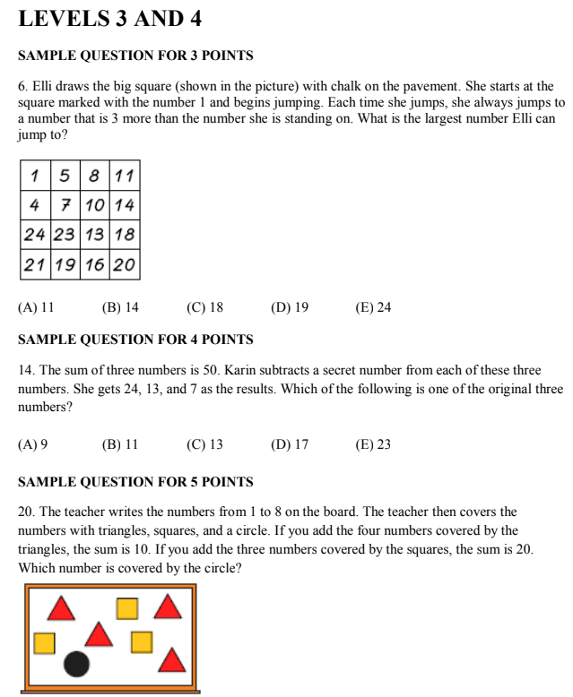
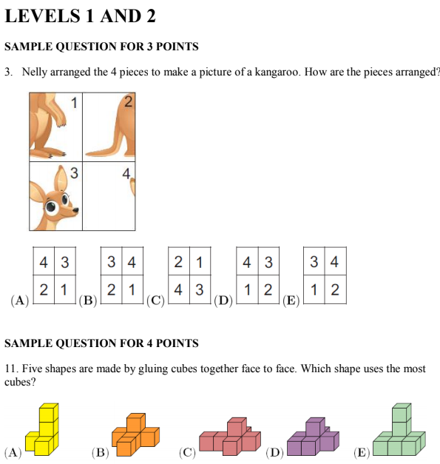
Sample Questions:

Slide 7

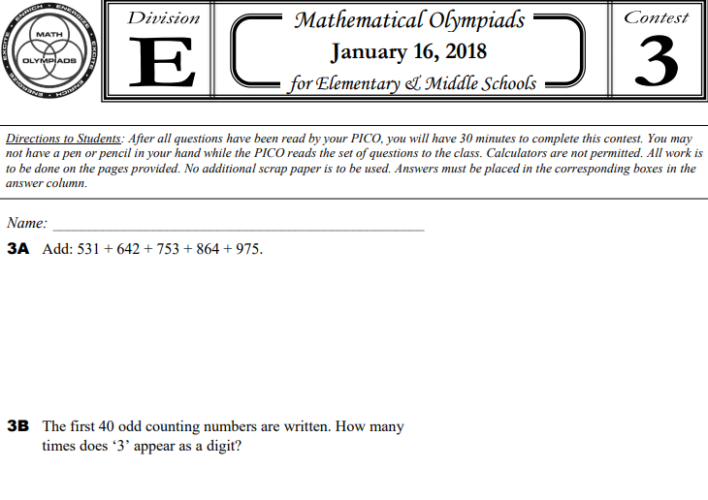
2 Divisions – in class contest only http://www.moems.org/
  Elementary (MOEMS, E division) – grades 4-5
  Middle (MOEMS, M division) – grades 6-8
5 monthly contests starting from November. 5 questions per contest
CACC math program offers such contests in class only

Slide 8

Middle School Only– (CACC cannot form a team)
4 levels of competition - school, chapter, state, and national
  School Round: End of January or early February
    Sprint Round: focuses on speed and accuracy. Students have 40 minutes to complete 30 math problems without a calculator.
    Target Round: focuses on problem-solving and mathematical reasoning. Students receive 4 sets of two problems and have 6 minutes to complete each set. Use of calculator allowed.
    Team Round: focuses on problem-solving and collaboration. Students have 20 minutes to complete 10 problems as a team.
    Countdown Round: focuses on speed and accuracy. Students have a maximum of 45 seconds per problem without a calculator.
  Chapter Competition in Late February: The winning team will advance to the State Competition. Additionally, the 2 highest-ranking competitors not on the winning team will advance to the State Competition. This is a minimum of 6 advancing Mathletes.
  State Competition in March
  National Competition in May
Join your school’s math club, then register.

Slide 9
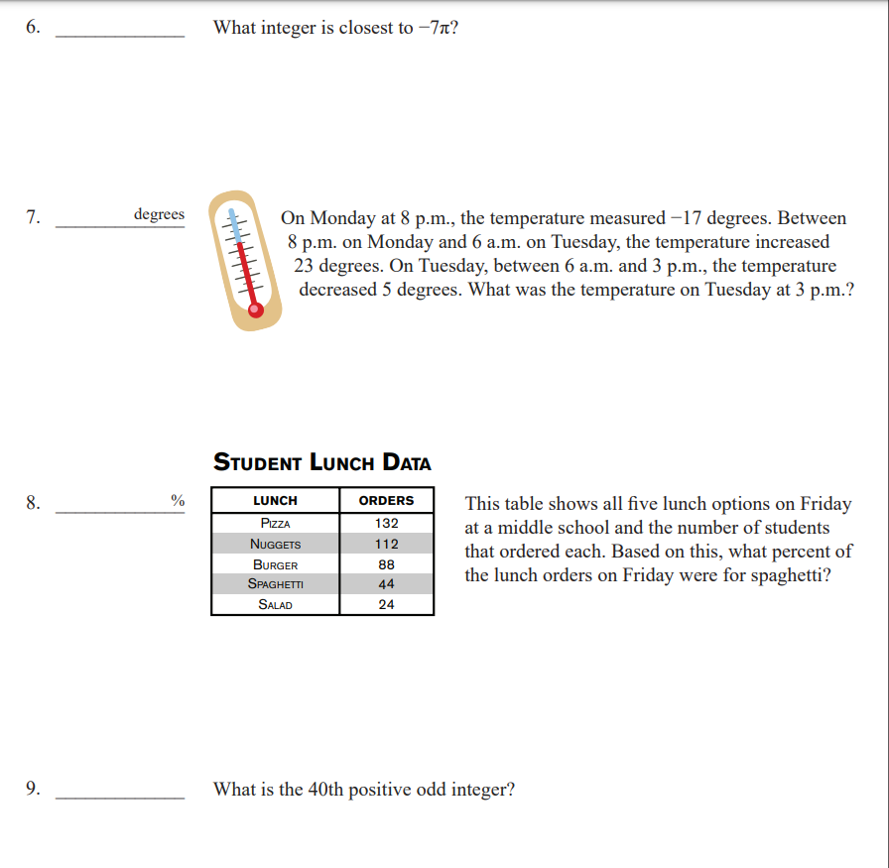
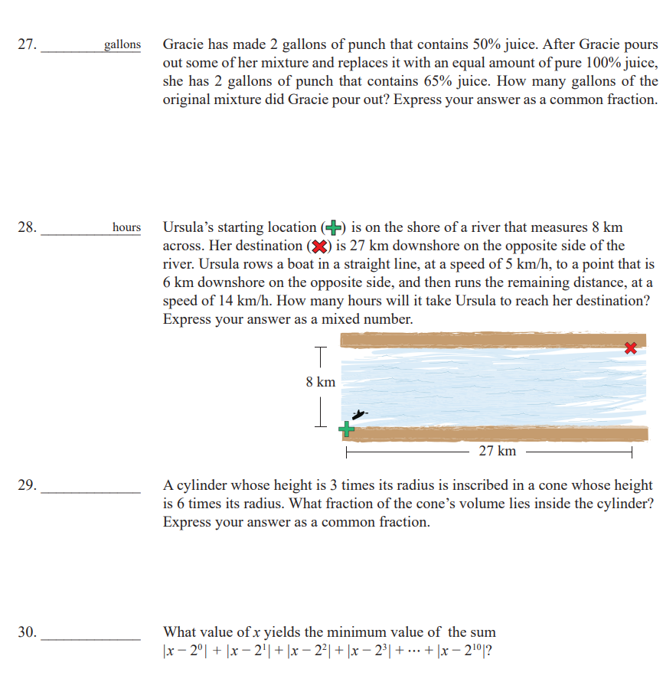
Sprint Round

Slide 10

American Math Competition (AMC)
AMC 8 (8th grade & below): 25 multiple choice Questions/ 40 minutes
Every January @ Thomas Hart Middle School MPR
AMC 8 Practice Link: AMC 8 Problems & Solutions
Year Honor Roll 5% Distinguished Honor Roll 1% Achievement Roll
2024 18 21 15
2023 17 21 15
2022 19 22 15
2020 18 21 15
2019 19 23 15
2018 15 19 15
2017 17 20 15
2016 18 22 15

Slide 11
2025 AMC 8 Test
AMC 8 (January 2025) 98,000 students in the U.S
Average Score: 11.75
15 points: Achievement Honor Roll for 6th grade and under
Top 5% HR: 19
Top 2.5%: 21
Top 1% DHR: 23
CACC AMC 8 Class: 23 students in total, 13 students voluntarily reported scores: 24, 21, 20, 19, 18, 16*3, 15*2, 14*2, 13

Slide 12
American Math Competition (AMC)
AMC 10 (10th grade & below): 25 Questions/75 minutes
AMC 10 A & AMC 10 B @ November
Both the A and the B versions of AMC 10 and AMC 12 have the same number of questions and rules of scoring, equal in difficulty and distribution of topics. The only differences are the competition dates, and that each version has a different set of questions.
A correct answer is worth 6 points, an unanswered question is worth 1.5 points, and a wrong answer is worth 0 points. The maximum score on the AMC 10 is 150 points. A common realistic initial target is 90 points on the AMC 10. Your final target will likely be 100-105 points on the AMC 10, the historical cutoffs for qualifying for the AIME.
2024 AMC 10 for AIME Floor: 94.5-105 top 7%
AIME (American Invitational Mathematics Exam→ USAJMO (USA Junior Mathematical Olympiad)→ Awards

Slide 13
American Math Competition (AMC)
AMC 12 (12th grade & below): 25 Qs/75 minutes) :
AMC 12A & AMC 12 B @ November
top 15% →AIME→ USAMO (USA Mathematical Olympiad) → MOSP (Math Olympiad Summer Program)→ IMO (International Math Olympiad)
2024 AIME Floor : 76.5-88.5
In 2025, 119,000 American students and 40,000 international students took AMC 10 & AMC 12
Usually 6000–7000 qualify for AMIE each year

Slide 14


Berkeley Mini Math Tournament
Middle School Students + Advanced 5th graders
5 students per team (CACC can form teams)
  Puzzle Round/Individual Round/Pacer Round/Team Round
Date: April, usually on a Sunday
Location: UC Berkeley Campus
Registration in CACC: $15
Test questions from past years: https://www.ocf.berkeley.edu/~bmt/archive/
Berkeley Math Tournament
High School students + Advanced 7th & 8th graders
Date: Fall

Slide 15
Math Classes We Offer
Competitive Math (CM) → Math Kangaroo
  Level 1: Grades 2-3
  Level 2: Grades 3-4
  Level 3: Grades 5-6
Understanding basic math concepts
Understanding competition problems
Identifying and interpreting graphs, pictures, and figures
Logic training
Basic calculations

Slide 16
Math Classes We Offer
MO Classes → Math Olympiads
Level 1: Grades 4-5
Level 2: Grades 5-6
Level 3: Grades 6-7
Mathcounts: Grades 6-8
stimulate students' interest and enthusiasm for problem solving
work on past Math Olympiads problems both individually and in groups
Problem solving skills
Solve problems accurately
Solve problems quickly and maintain a steady pace
5 in-class Math Olympiad competitions from Dec to April

Slide 17
Math Classes We Offer
AMC 8 - Preparation for AMC 8 Competition
Recurring concepts and problem-solving strategies.
Focuses on AMC 8 test questions from #10 to #20 before test date. Encourage students to try #20 to #25 and AMC 10 #1 to #5 after the test date .
AMC 10 - Preparation for AMC 10 Competition
Problem solving skills in number theory, algebra, geometry, and counting and probability.
Students are expected to do considerable amount of homework.
Focuses mostly on AMC 10 up to question #15.
New: One hour on-site class + one hour online discussion
64-hour course
Online discussion section: Lead by high school TA who was a winner of the competition, focusing on homework and emphasizing student interaction.

Slide 18


There are a lot of exciting moments in math competitions,
as well as disappointing moments.
Start Early and Be Patient

